Slide 1
System Identification to support and enhance Flight Testing
23.02.2018
A project proposal
Alejandro Valverde
Notes:
Hello everyone, my name is Alejandro Valverde and I have an idea. Idea which I would like to propose to you today.
For those of you already initiated in this topic, I would like to implement System ID techniques into the current Flight Testing methodology. I would do this in a:
Cost effective,
Efficient, and
Accurate,
ways. And in this presentation, I will describe how I want to do this.
Now, for those of you not initiated in this topic…

Slide 2
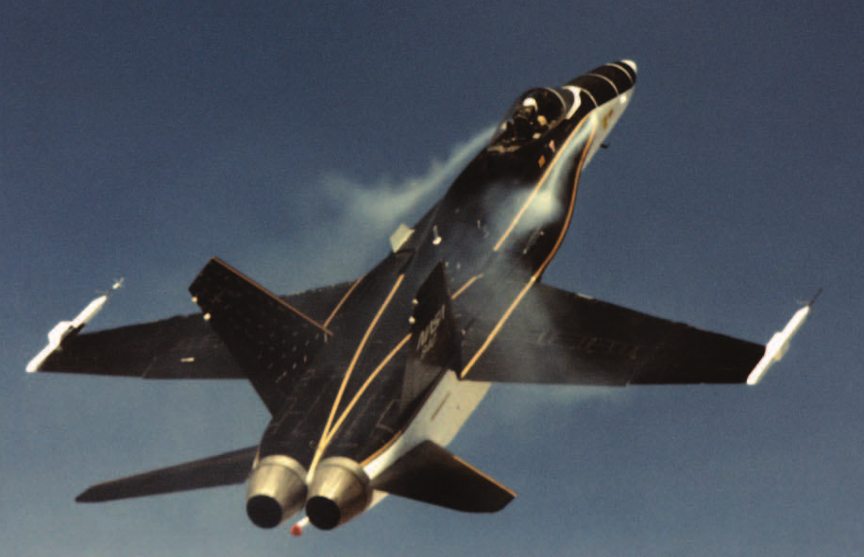
Aircraft System Identification
System Identification is the process of building mathematical models for physical systems based on imperfect observations or measurements
When applied to aircraft, it is called Aircraft System Identification
@ Kopter Group AG | Alejandro Valverde
Notes:
One of the oldest and most fundamental of all human scientific pursuits is developing mathematical models for physical systems based on imperfect observations or measurements. This activity is known as system identification. When applied to aircraft, this is known as system identification.
And this is in fact one of the reasons why I am so interested in this topic, This discipline is fairly unknown in the aerospace industry, but it is in fact something that scientists and engineers have been doing for hundreds of years.
I like to recall know the contribution to human progress made by Johannes Kepler when, in 1609, he published the book Astronomia nova which presented a mathematical model that describe the motion of the planets in the Solar System. For this, he collaborated with the Swedish Tycho Brahe, who provided him with precise data of planets position in the sky. This was System Identification.

Slide 3
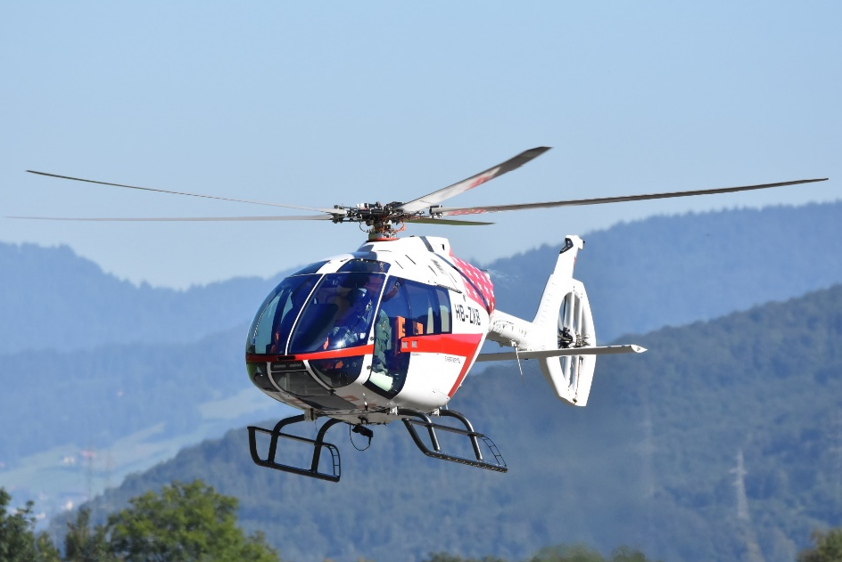
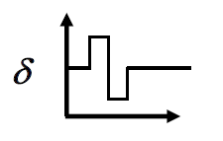
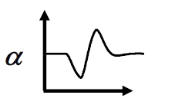
Problems in Aircraft Dynamics
Input, u
Output, z
System, S
Simulation: Given u and S, find z
Control: Given z and S, find u
Identification: Given z and u, find S
@ Kopter Group AG | Alejandro Valverde
Notes:
Now, in our company, we have already covered some of the classical problems of Aircraft Dynamics.
Simulation: This is what the guys from Flight Physics do when they use FlightLab
Control: This is what our pilot does in his brain.. Since, we don’t have yet developed an autopilot, we don’t need to worry too much about this point.
Identification: Here is when we obtain a model for our helicopter, considering both the input and output to the model.
For Kepler, this box was ocuppaid by the solar universy, for us this is the SH09; but in fact it same. Well, in fact, poor Kepler’s task was harder than us becaue he did have control over the inputs to the system and we do have.

Slide 4
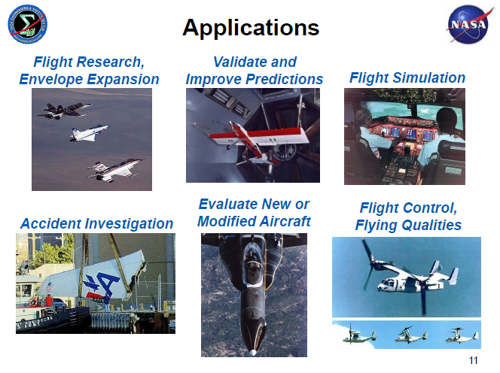
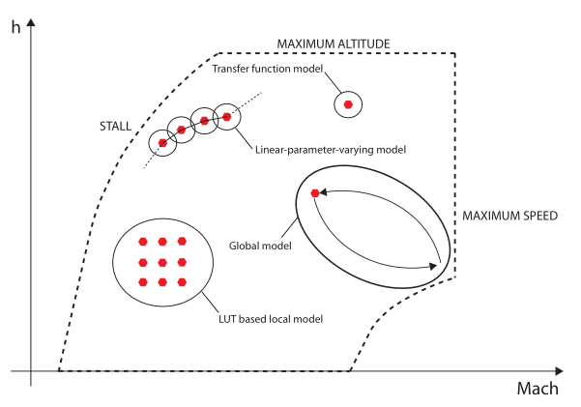
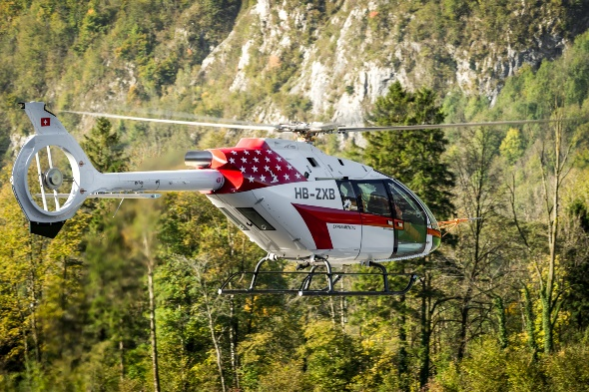
Applications of Aircraft System ID techniques
Aircraft System Identification offers a wide range of different applications, including:
Flight Simulator development
Flight envelope expansion
Picture of the flight simulator in the basement
Evaluation of new aircraft
Handling Qualities assessment
and enhancement
And many others…
@ Kopter Group AG | Alejandro Valverde

Slide 5
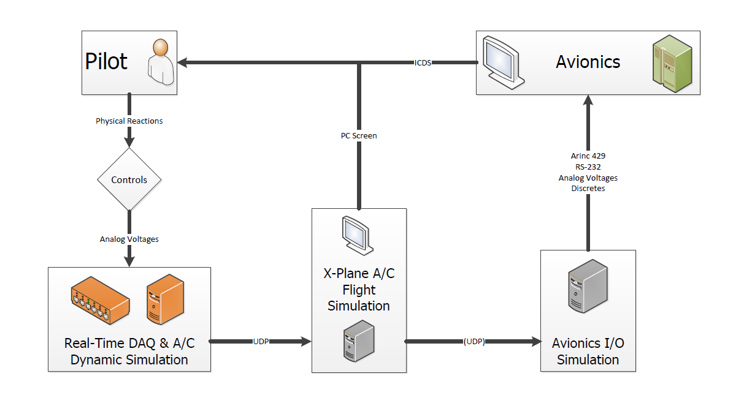
Aircraft Simulation - Ongoing Kopter project
Extracted from Nicolas’ MSc Thesis overview in collaboration with Kopter Avionics Dep.
@ Kopter Group AG | Alejandro Valverde

Slide 6
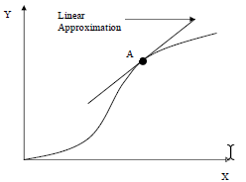

Aircraft Simulation – Current Kopter approach
Dynamic Simulation
Trimmed condition of FlightLab, e.g.:
Non-linear model
fwd level flight @ 100kts
Linear model
linearization of full H/C dynamics:
Suitable for:
$$\dot{x}=Ax+Bu$$
$$y=Cx+Du$$
FCS design
H/C flight simulation
Aircraft dynamic stability analysis
@ Kopter Group AG | Alejandro Valverde

Slide 7
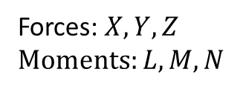
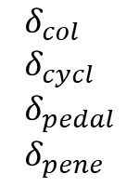
Aircraft Simulation – Current Kopter approach
Dynamic Simulation
$$δ_{col} \\ δ_{cycl} \\ δ_{pedal} \\ δ_{pene}$$
Non-linear model
Pilot inputs
Aerodynamic H/C model
Equations of Motion
Forces: $X,Y,Z$ Moments: $L,M,N$
System ID provides an accurate, simple and reliable model of the H/C dynamics obtained from real flight test data of the real H/C
LUTs
@ Kopter Group AG | Alejandro Valverde
Notes:
Accurate -> Because it’s based on real flight data
Simple -> Does not require high computational power
Reliable -> Computed with

Slide 8
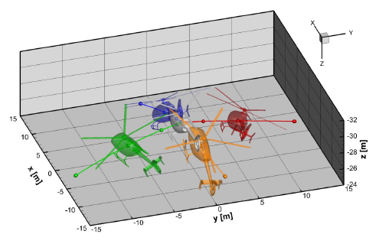
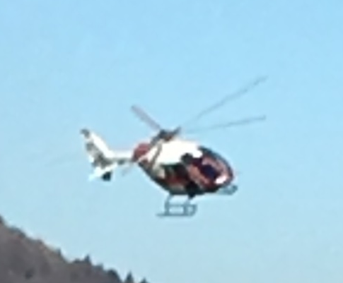
System ID R/C Model vs FlightLab
H/C model from System ID
FlightLab H/C model
Advantages:
High accuracy
Validation -> instantaneous
Non-linear flight dynamics
Transient flight conditions
Real-time dynamic modelling
Drawbacks:
Depend on flight test data availability
Advantages:
Not dependency on flight test data
Drawbacks:
Validation -> complicated
Only linear flight dynamics
Best use: Dynamic model of the
real H/C
Best use: Loads prediction
@ Kopter Group AG | Alejandro Valverde

Slide 9
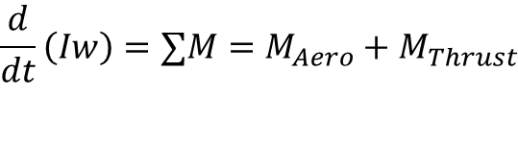
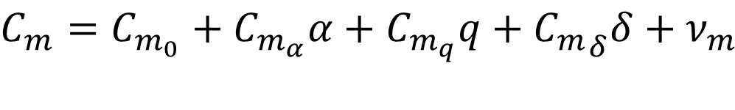
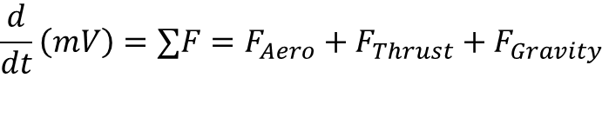
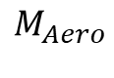
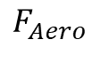
How does it work?
$$\frac{d}{dt}\left(mV\right)=∑F=F_{Aero}+F_{Thrust}+F_{Gravity}$$
Forces and moments
$$\frac{d}{dt}\left(Iw\right)=∑M=M_{Aero}+M_{Thrust}$$
$$F_{Aero}$$
Develop a model form from which parameters can be estimated using flight test data
$$M_{Aero}$$
for example, using Taylor series expansion
Pitching moment coefficient
longitudinal angular velocity
H/C angle of attack
pitch control input
$$C_{m}=C_{m_{0}}+C_{m_{α}}α+C_{m_{q}}q+{C_{m}}_{δ}δ+ν_{m}$$
pitching moment bias
static stability
dynamic stability (damping)
pitch control authority
@ Kopter Group AG | Alejandro Valverde

Slide 10



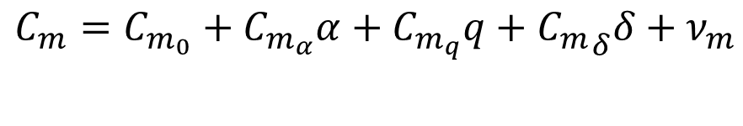

How does it work?
Pitching moment model:
$$C_{m}=C_{m_{0}}+C_{m_{α}}α+C_{m_{q}}q+{C_{m}}_{δ}δ+ν_{m}$$
$y:$ Model output
$θ:$ Regresors
X: Values of variables measured
$z:$ Observations
$ν:$ Noise of the measurement
$$θ={\left[ C_{m_{0}},C_{m_{α},}C_{m_{q}},C_{m_{δ}}\right]}^{′}$$
Vector of regressors (parameters to be identified)
Observations$z$
Model:
- Simple
- In flight on fly estimations
Equation-Error
Solved in one-shot linear algebra
$$y=X θ \\ z=X θ+ν$$
two approaches
Solved with iterative nonlinear optimization
- Any nonlinear system dynamics
- Machine learning techniques
Output-Error
@ Kopter Group AG | Alejandro Valverde

Slide 11
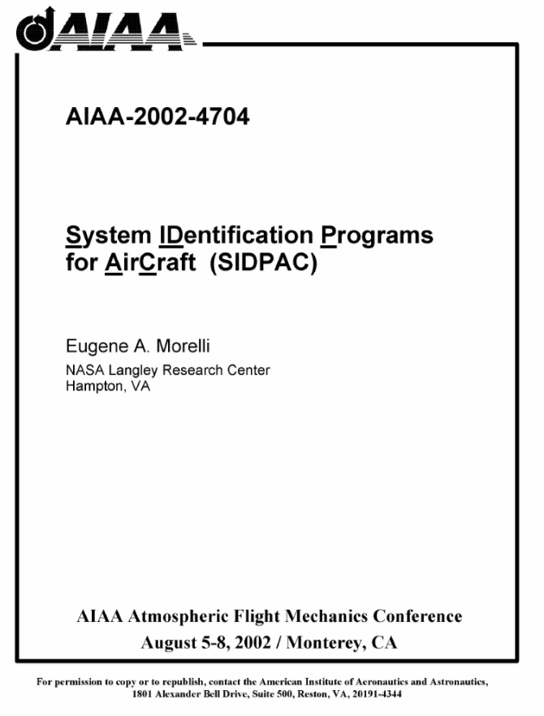
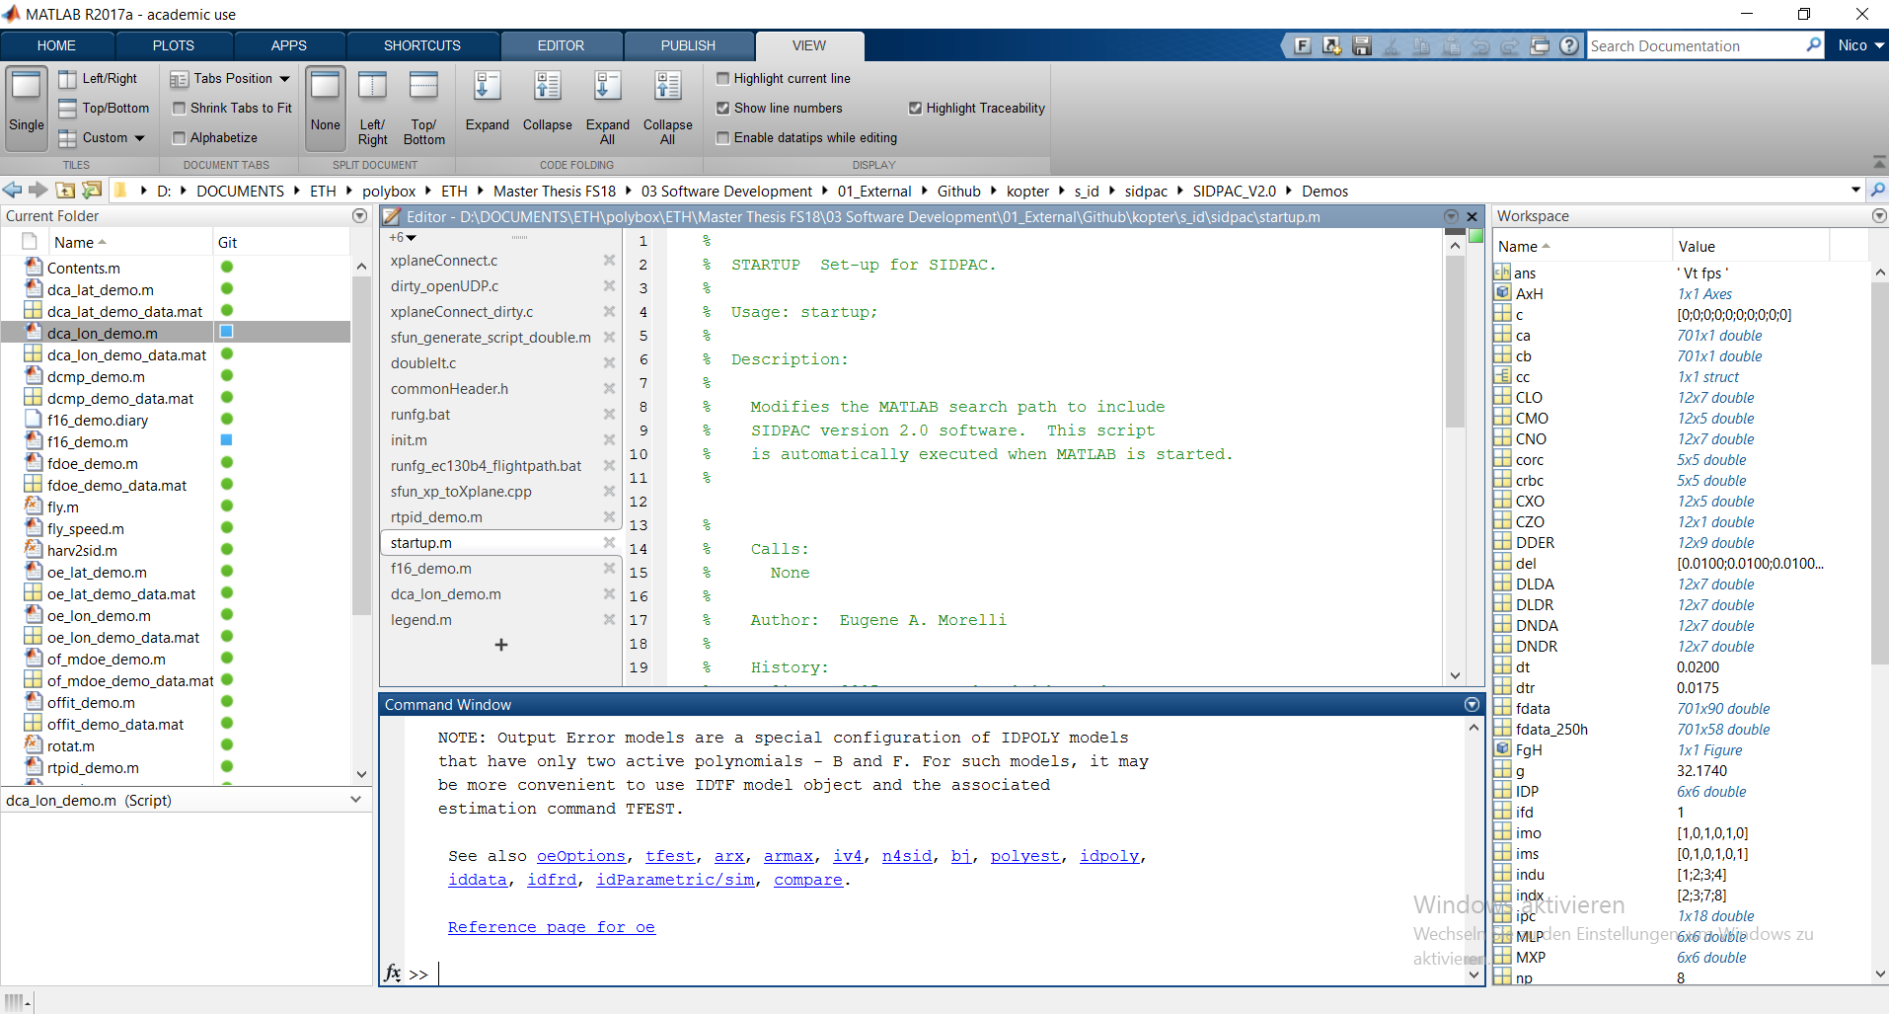
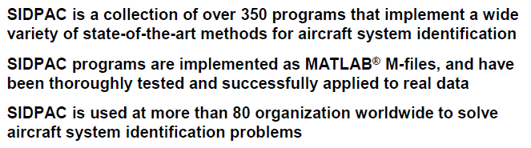
Tools – SIDPAC software
Already available
No development time needed
Proven industry suitable software
Further ways:
Python implementation
@ Kopter Group AG | Alejandro Valverde

Slide 12
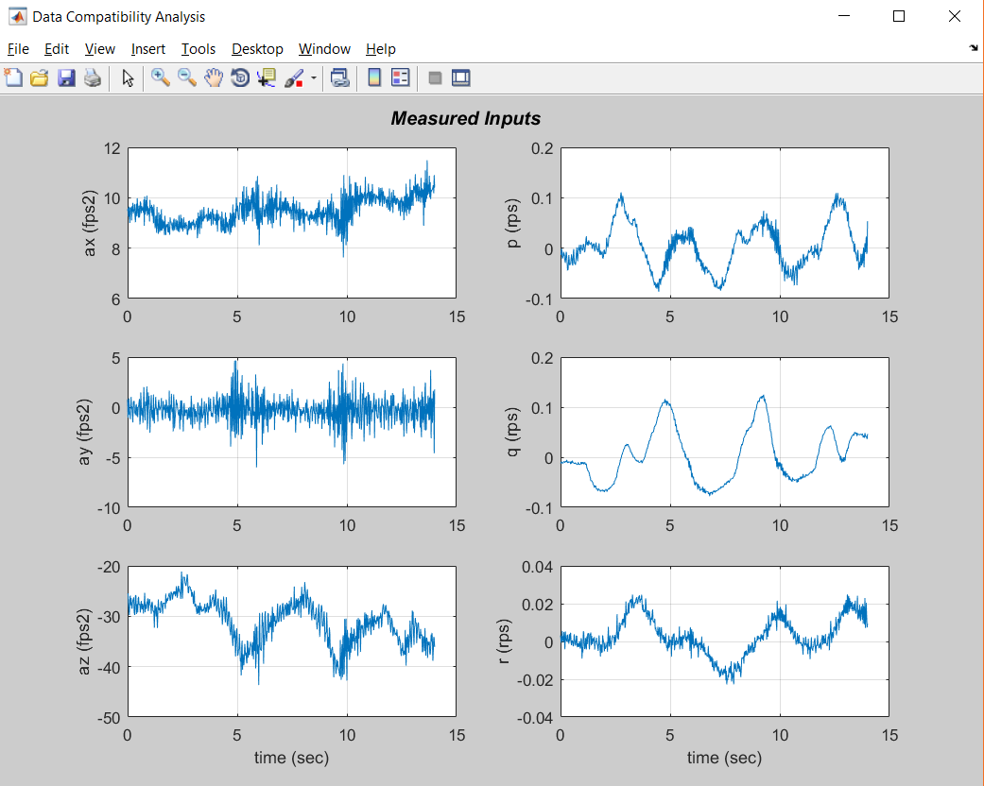
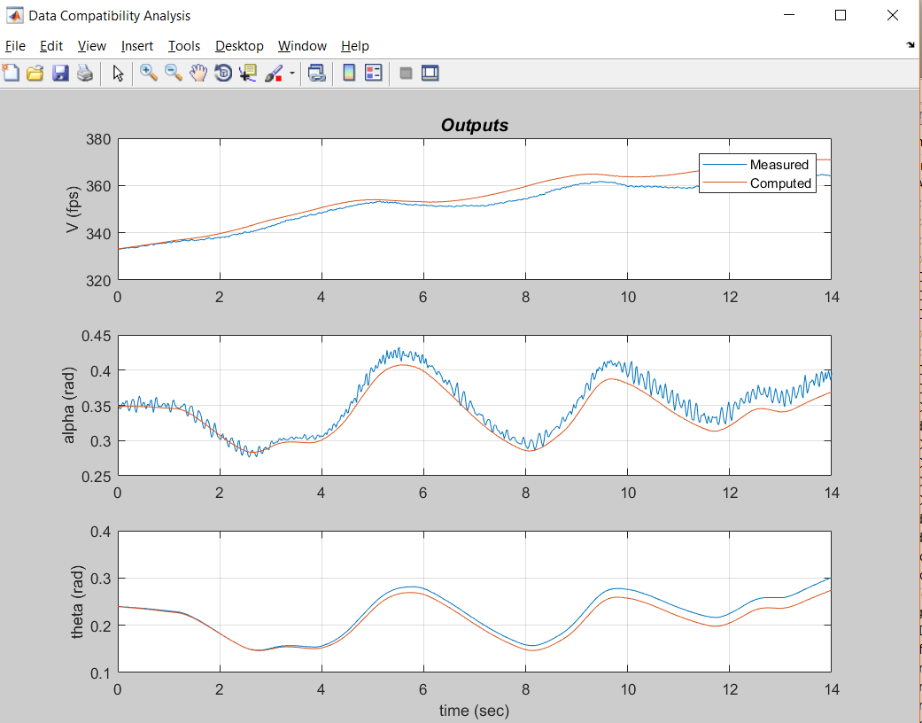
Tools – SIDPAC software

Slide 14
What would I need?
some accelerometers installed in P3, a part from the usual instrumentation… -> we already have this
A laptop
Some coffee
@ Kopter Group AG | Alejandro Valverde

Slide 15
Why to introducing System ID into P3 test campaign?
Sooner or later –> Every big helicopter manufacturer has SID implemented
Assist P3 flight envelope expansion
Provide a propor dynamic model of the H/C for the simulator
Cost effective
Surely it will be need for PS4 and further developments after TC
System ID takes time and money – but not nearly as much as not doing it Eugene A. Morelli NASA Langley Research Center Hampton
We have to do it now,
we are ready now
@ Kopter Group AG | Alejandro Valverde

Slide 16
Why I can be the one doing this?
Young <-> Passion
I know what to do and how to do it
Kopter experience
Data analysis experience
Python
Matlab
Data analysis and machine learning techniques
…
@ Kopter Group AG | Alejandro Valverde

Slide 17
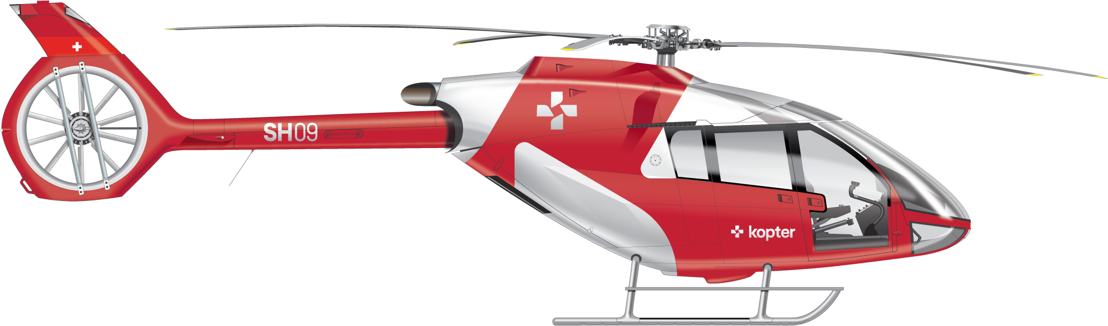
@ Kopter Group AG | Alejandro Valverde

Slide 18
Thank you

Slide 19
References
[1]: Aircraft System Identification. Theory and Practice.
@ Kopter Group AG | Alejandro Valverde

